Slide 1

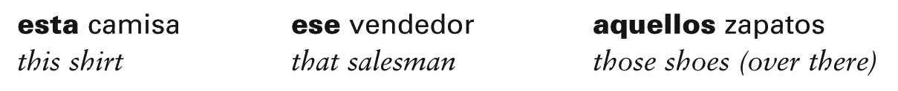
Demonstrative adjectives
In Spanish, as in English, demonstrative adjectives are words that “demonstrate” or “point out” nouns. Demonstrative adjectives precede the nouns they modify and, like other Spanish adjectives you have studied, agree with them in gender and number. Observe these, then study the following chart.

Slide 2
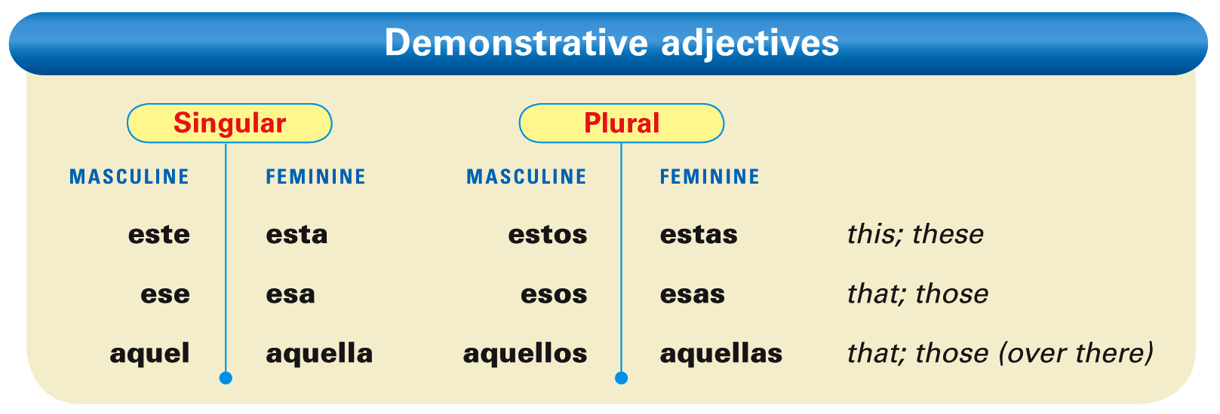

Slide 3
There are three sets of demonstrative adjectives. To determine which one to use, you must establish the relationship between the speaker and the noun(s) being pointed out.

Slide 4
The demonstrative adjectives este, esta, estos, and estas are used to point out nouns that are close to the speaker and the listener.

Slide 5
The demonstrative adjectives ese, esa, esos, and esas are used to point out nouns that are not close in space and time to the speaker. They may, however, be close to the listener.

Slide 6
The demonstrative adjectives aquel, aquella, aquellos, and aquellas are used to point out nouns that are far away from the speaker and the listener.

Slide 7
Demonstrative pronouns
Demonstrative pronouns are identical to their corresponding demonstrative adjectives, with the exception that they carry an accent mark on the stressed vowel.

Slide 8
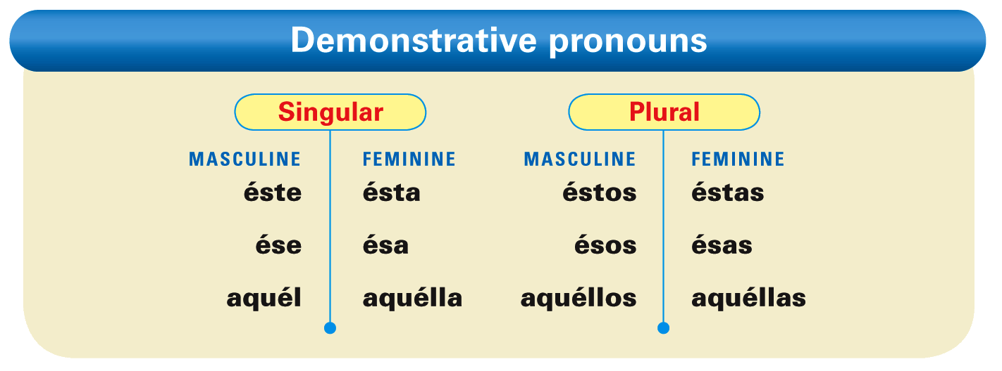

Slide 9
¡Atención! Like demonstrative adjectives, demonstrative pronouns agree in gender and number with the corresponding noun.

Slide 10
There are three neuter demonstrative pronouns: esto, eso, and aquello. These forms refer to unidentified or unspecified nouns, situations, ideas, and concepts. They do not change in gender or number and never carry an accent mark.

Slide 11
Provide the correct form of the demonstrative adjective for these nouns. The first item has been done for you.
la falda / este ____________ los estudiantes / este _________ los países / aquel ____________ la ventana / ese ____________ | los periodistas / ese ____________ el chico / aquel ____________ las sandalias / este ____________ las chicas / aquel ____________
esta falda

